Slide 1

Department of Computer Science, CUI Lahore Campus
Formal Methods in Software Engineering
By
Farooq Ahmad

Slide 2
Introduction to Formal Methods
Conditional statements

Slide 3
Topics to be discussed
Conditional statement
Truth table for conditional statement
Implication form of conditional statement

Slide 4
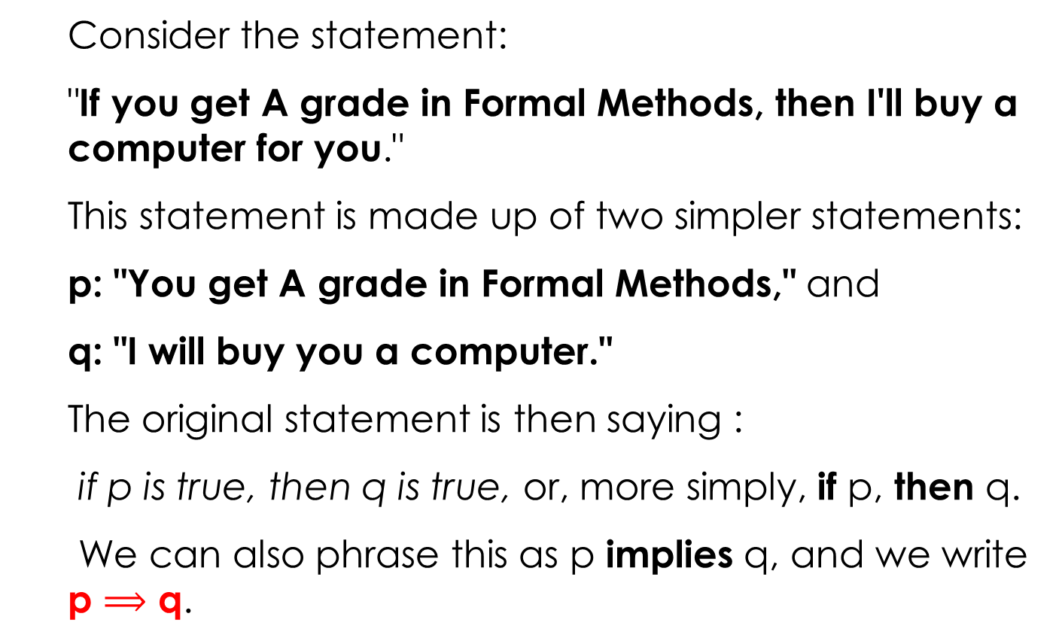
CONDITIONAL STATEMENTS
Consider the statement:
"If you get A grade in Formal Methods, then I'll buy a computer for you."
This statement is made up of two simpler statements:
p: "You get A grade in Formal Methods," and
q: "I will buy you a computer."
The original statement is then saying :
if p is true, then q is true, or, more simply, if p, then q.
We can also phrase this as p implies q, and we write p $⟹$ q.

Slide 5
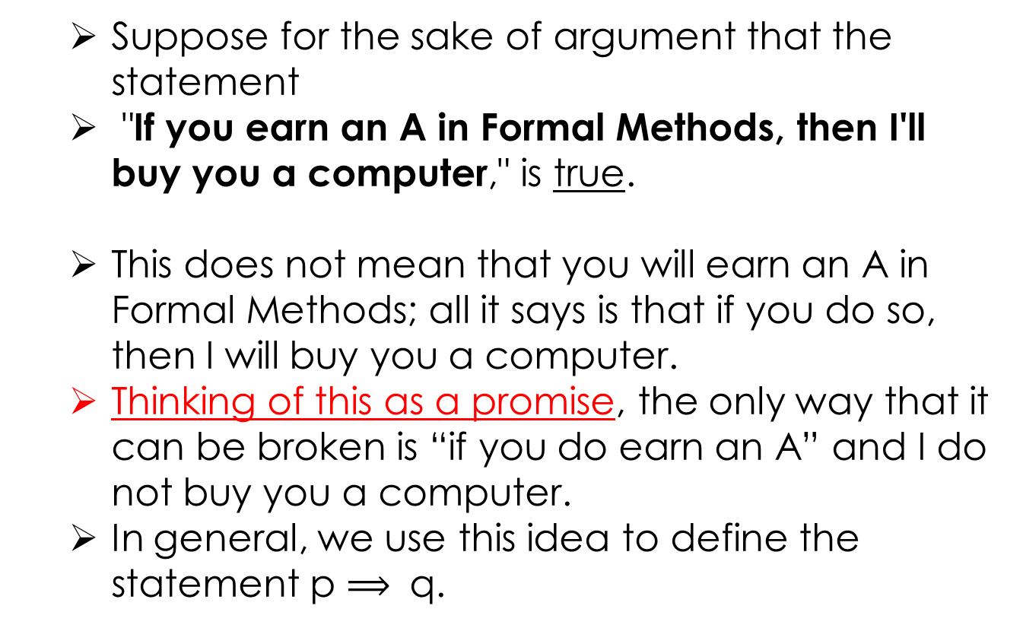
EXPLANATION
Suppose for the sake of argument that the statement
"If you earn an A in Formal Methods, then I'll buy you a computer," is true.
This does not mean that you will earn an A in Formal Methods; all it says is that if you do so, then I will buy you a computer.
Thinking of this as a promise, the only way that it can be broken is “if you do earn an A” and I do not buy you a computer.
In general, we use this idea to define the statement p $⟹$ q.

Slide 6
EXAMPLE
Suppose you go to interview for a job at a store and the owner of the store makes you the following promise:
“If you show up for work Monday morning, then you will get the job”.
After all, the owner’s promise only says you will get the job if a certain condition (showing up for work Monday morning) is met;
It says nothing about what will happen if the condition is not met.

Slide 7
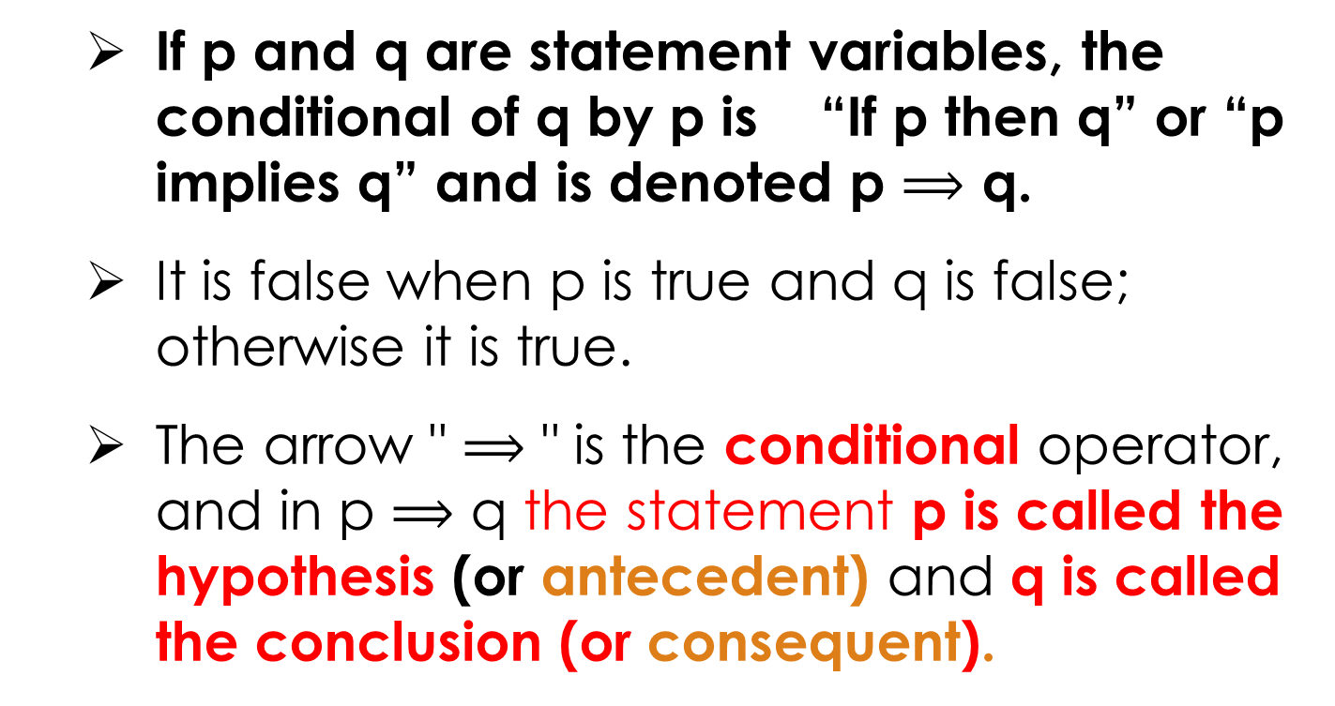
CONDITIONAL STATEMENTS OR IMPLICATIONS
If p and q are statement variables, the conditional of q by p is “If p then q” or “p implies q” and is denoted p $⟹$ q.
It is false when p is true and q is false; otherwise it is true.
The arrow " $⟹$ " is the conditional operator, and in p $⟹$ q the statement p is called the hypothesis (or antecedent) and q is called the conclusion (or consequent).

Slide 8
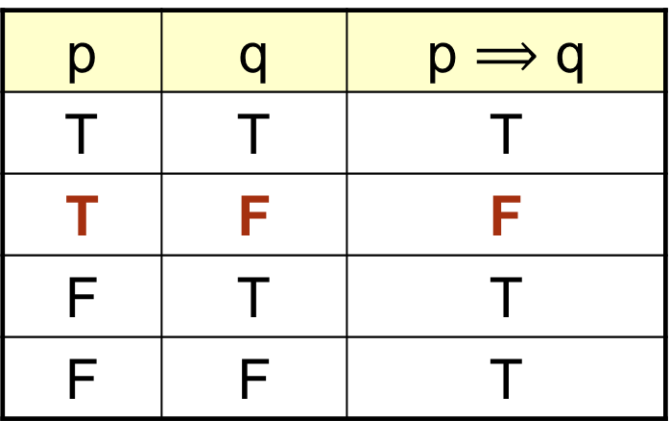

TRUTH TABLE FOR p $⟹$ q
p | q | p $⟹$ q
T | T | T
T | F | F
F | T | T
F | F | T

Slide 9

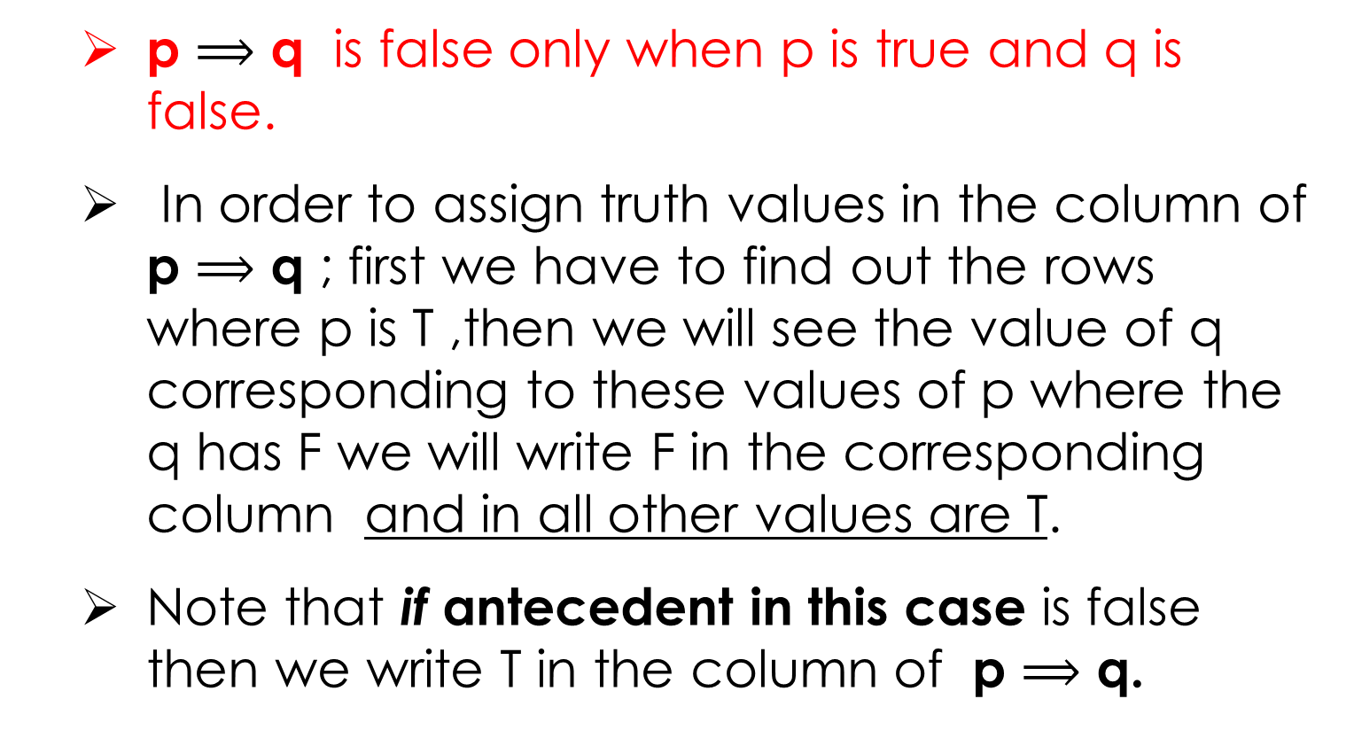
Truth values of p $⟹$ q
p $⟹$ q is false only when p is true and q is false.
In order to assign truth values in the column of p $⟹$ q ; first we have to find out the rows where p is T ,then we will see the value of q corresponding to these values of p where the q has F we will write F in the corresponding column and in all other values are T.
Note that if antecedent in this case is false then we write T in the column of p $⟹$ q.

Slide 10
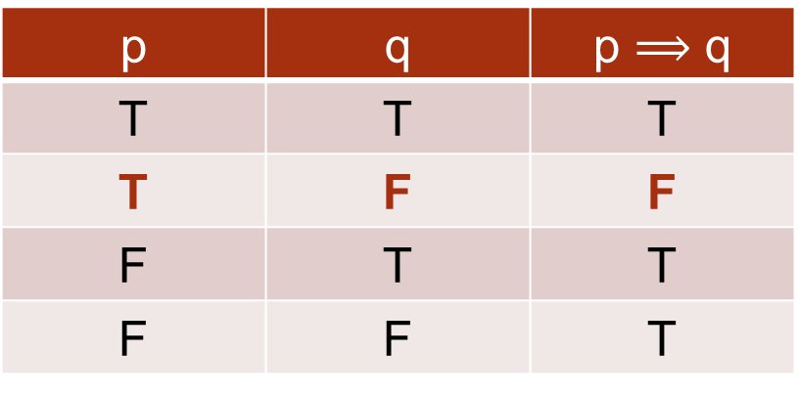
Example of implication form
If there are no clouds then there is no rain
p = There are no clouds, q = There is no rain
p | q | p $⟹$ q
T | T | T
T | F | F
F | T | T
F | F | T
The left-hand operand of the implication operator is known as the antecedent and the right-hand operand is known as the
consequent.

Slide 11
PRACTICE WITH CONDITIONAL STATEMENTS
Determine the truth value of each of the following conditional statements:
“If 1 = 1, then 3 = 3.”
TRUE
“If 1 = 1, then 2 = 3.”
FALSE
“If 1 = 0, then 3 = 3.”
TRUE
“If 1 = 2, then 2 = 3.”
TRUE
“If 1 = 1,then 1 = 2 and 2 = 3.”
FALSE
“If 1 = 3 or 1 = 2 then 3 = 3.”
TRUE

Slide 12
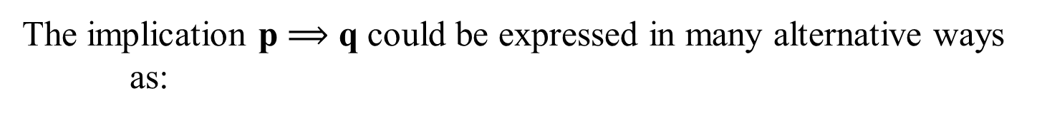
ALTERNATIVE WAYS OF EXPRESSING IMPLICATIONS
The implication p $⟹$ q could be expressed in many alternative ways as:
“if p then q”
“p implies q”
“if p, q”
“p only if q”
“p is sufficient for q”
“not p unless q”
“q follows from p”
“q if p”
“q whenever p”
“q is necessary for p”

Slide 13
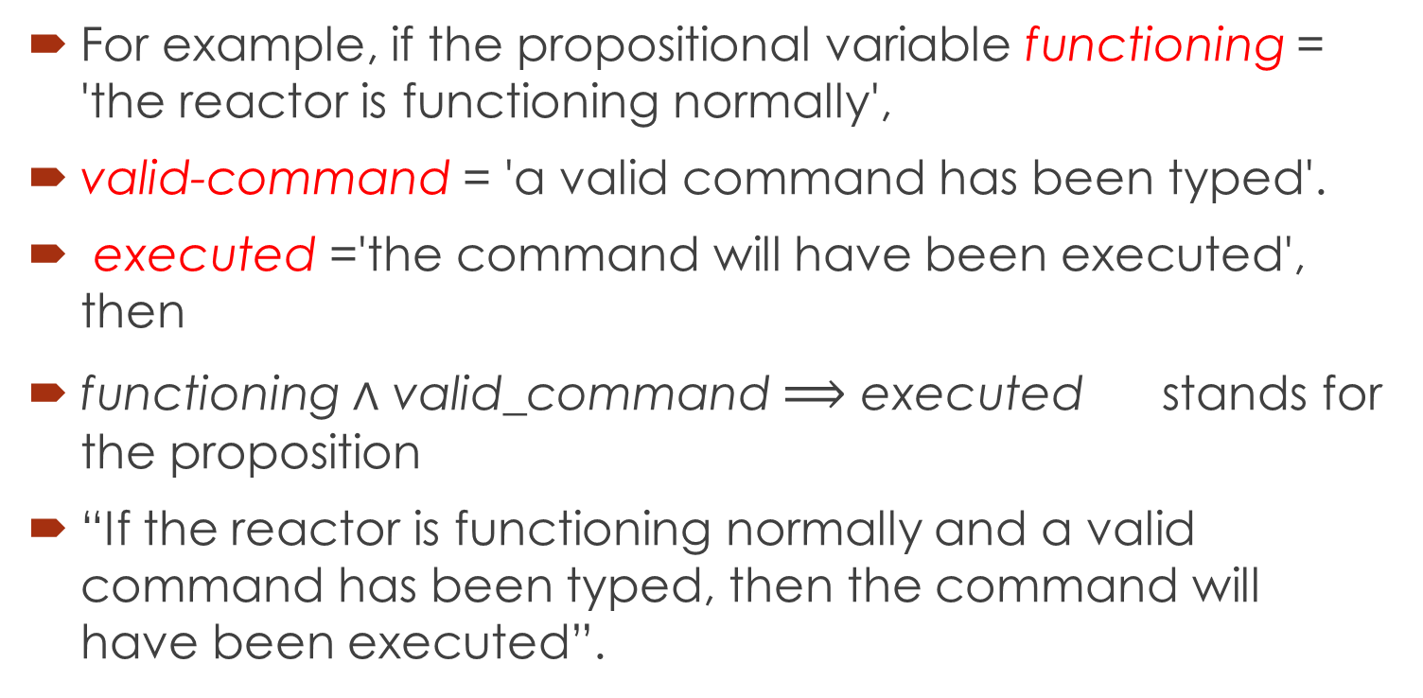
Example
For example, if the propositional variable functioning = 'the reactor is functioning normally',
valid-command = 'a valid command has been typed'.
executed ='the command will have been executed', then
functioning $∧$ valid_command $⟹$ executed stands for the proposition
“If the reactor is functioning normally and a valid command has been typed, then the command will have been executed”.

Slide 14
EXERCISE
Write the following statements in the form “if p, then q” in English.
Your guarantee is valid ONLY IF you bought your CD less than 90 days ago.
If your guarantee is valid, then you must have bought your CD player less than 90 days ago.
To get tenure as a professor, it is sufficient to be world-famous.
If you are world-famous, then you will get tenure as a professor.
That you get the job implies that you have the best credentials.
If you get the job, then you have the best credentials.
It is necessary to practice 8 hours to get to the job in a software house.
If you get the job in a software house, then you must have practiced 8 hours.

Slide 15
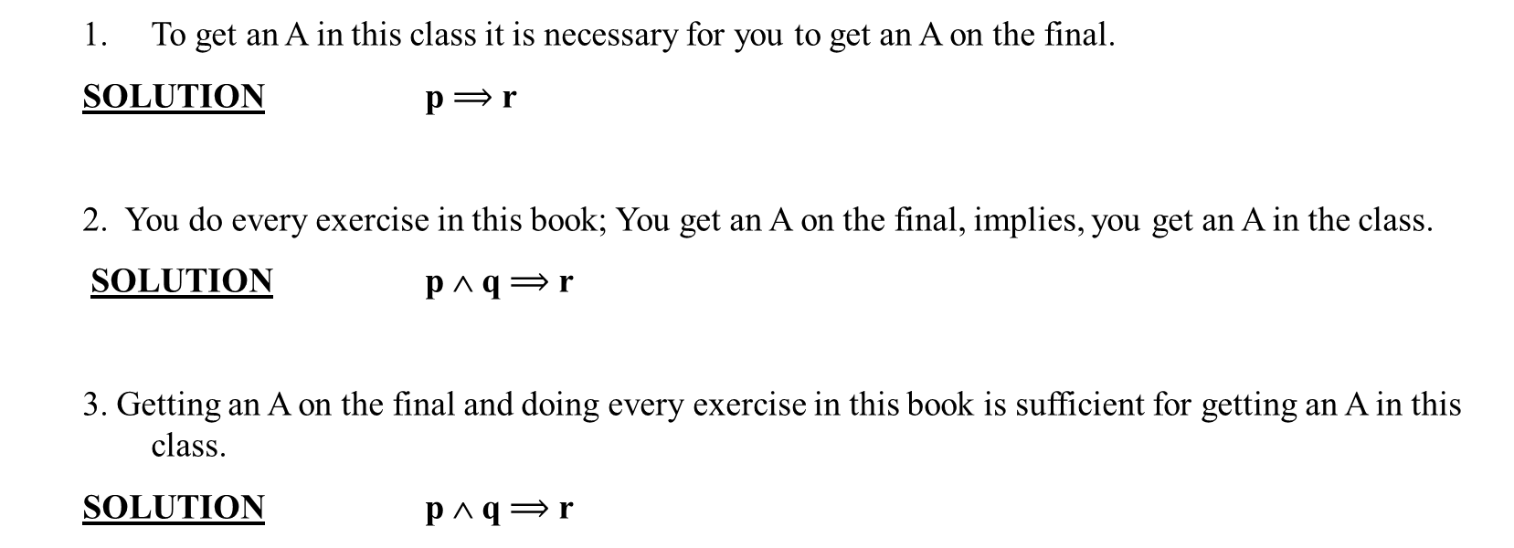
TRANSLATING ENGLISH SENTENCES TO SYMBOLS
Let p and q be propositions:
p = “you get an A on the final exam”, q = “you do every exercise in this book”
r = “you get an A in this class”
Write the following propositions using p, q, and r and logical connective
To get an A in this class it is necessary for you to get an A on the final.
SOLUTION p $⟹$ r
2. You do every exercise in this book; You get an A on the final, implies, you get an A in the class.
SOLUTION p ∧ q $⟹$ r
3. Getting an A on the final and doing every exercise in this book is sufficient for getting an A in this class.
SOLUTION p ∧ q $⟹$ r

Slide 16
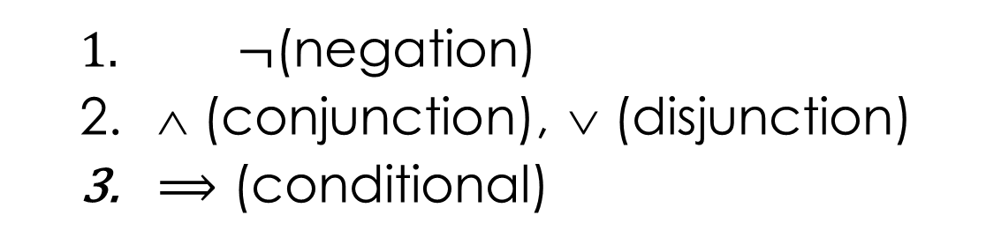
HIERARCHY OF OPERATIONS FOR LOGICAL CONNECTIVES
$¬$(negation)
∧ (conjunction), ∨ (disjunction)
$⟹$ (conditional)

Slide 17
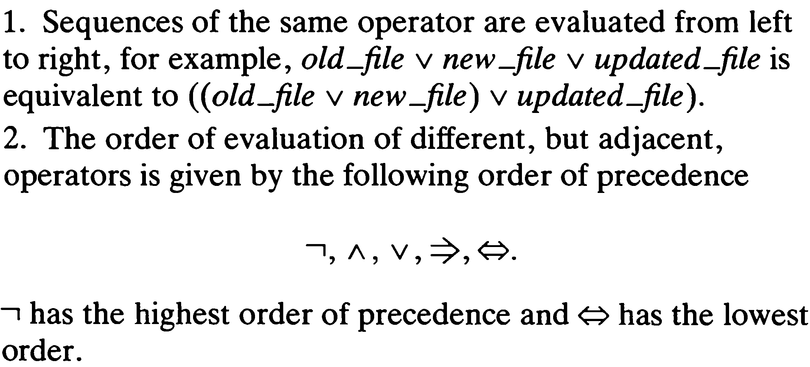
Precedence of operators

Slide 18
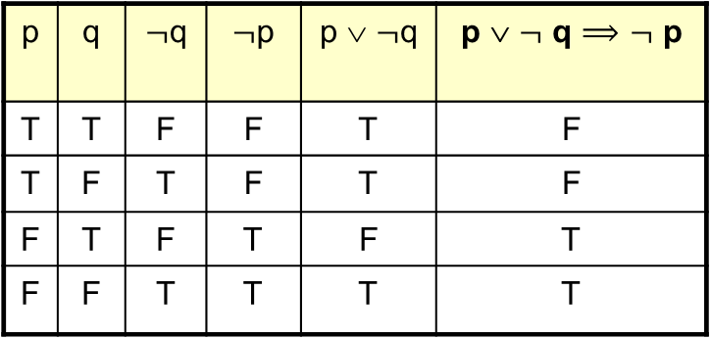
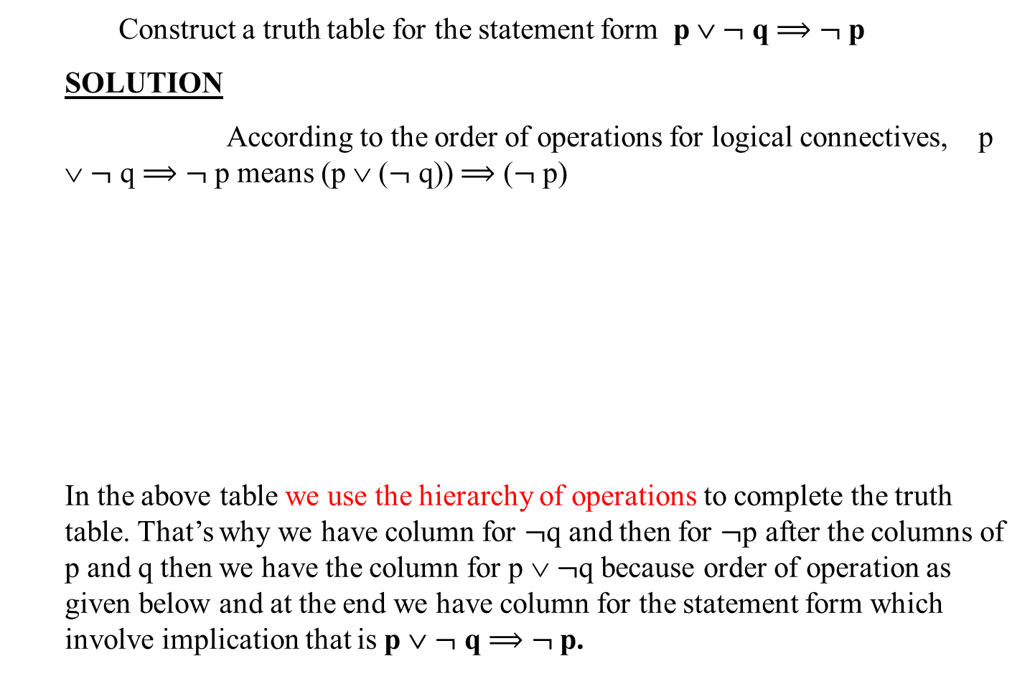
EXAMPLE
Construct a truth table for the statement form p ∨ $¬$ q $⟹$ $¬$ p
SOLUTION
According to the order of operations for logical connectives, p ∨ $¬$ q $⟹$ $¬$ p means (p ∨ ($¬$ q)) $⟹$ ($¬$ p)
In the above table we use the hierarchy of operations to complete the truth table. That’s why we have column for $¬$q and then for $¬$p after the columns of p and q then we have the column for p ∨ $¬$q because order of operation as given below and at the end we have column for the statement form which involve implication that is p ∨ $¬$ q $⟹$ $¬$ p.
p | q | $¬$q | $¬$p | p ∨ $¬$q | p ∨ $¬$ q $⟹$ $¬$ p
T | T | F | F | T | F
T | F | T | F | T | F
F | T | F | T | F | T
F | F | T | T | T | T

Slide 19
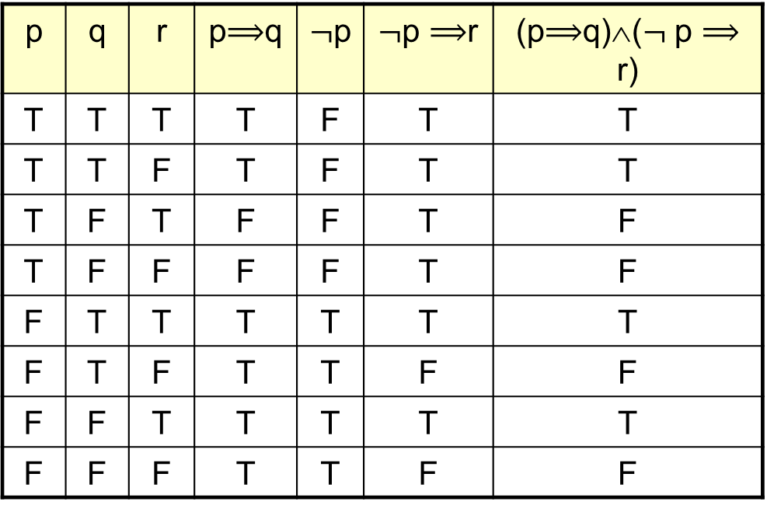
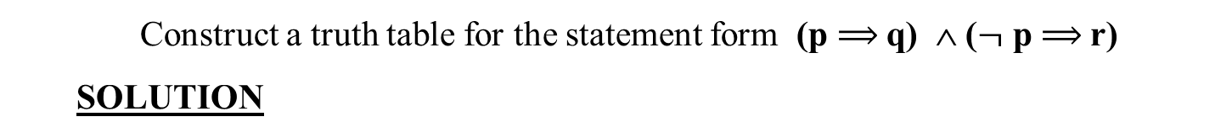
EXAMPLE
Construct a truth table for the statement form (p $⟹$q) ∧ ($¬$ p $⟹$r)
SOLUTION
p | q | r | p$⟹$q | $¬$p | $¬$p $⟹$r | (p$⟹$q)∧($¬$ p $⟹$ r)
T | T | T | T | F | T | T
T | T | F | T | F | T | T
T | F | T | F | F | T | F
T | F | F | F | F | T | F
F | T | T | T | T | T | T
F | T | F | T | T | F | F
F | F | T | T | T | T | T
F | F | F | T | T | F | F

Slide 20
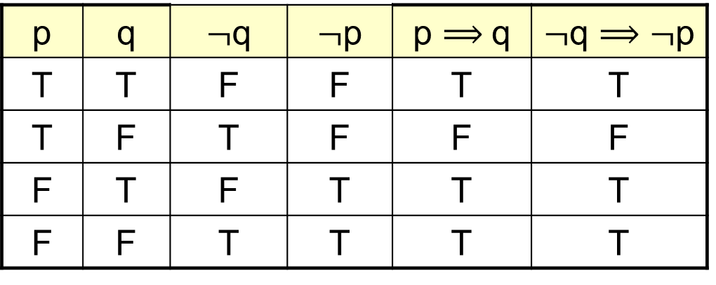
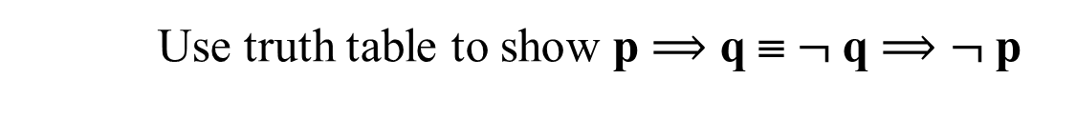
LOGICAL EQUIVALENCE INVOLVING IMPLICATION
Use truth table to show p $⟹$ q ≡ $¬$q $⟹$ $¬$p
p | q | $¬$q | $¬$p | p $⟹$q | $¬$q $⟹$ $¬$p
T | T | F | F | T | T
T | F | T | F | F | F
F | T | F | T | T | T
F | F | T | T | T | T

Slide 21
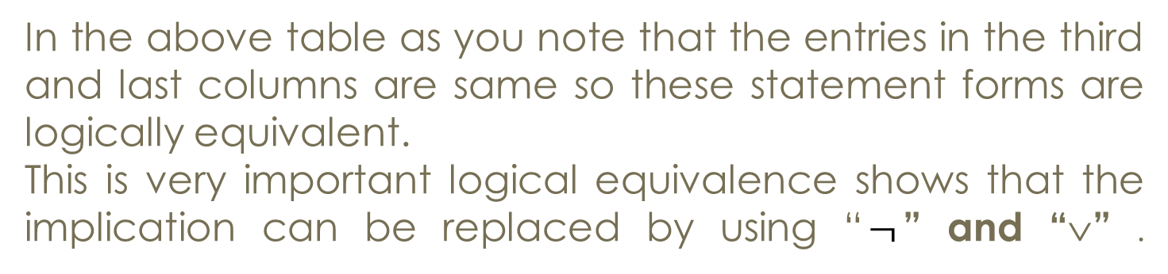
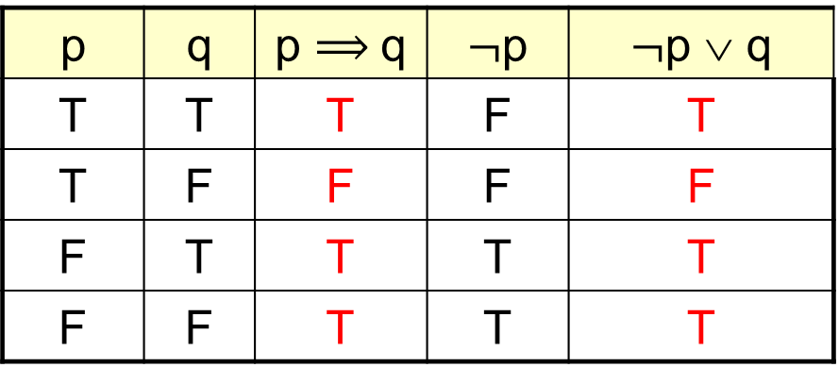

IMPLICATION LAW p $⟹$ q ≡ $¬$ p ∨ q
p | q | p $⟹$q | $¬$p | $¬$p ∨ q
T | T | T | F | T
T | F | F | F | F
F | T | T | T | T
F | F | T | T | T
In the above table as you note that the entries in the third and last columns are same so these statement forms are logically equivalent.
This is very important logical equivalence shows that the implication can be replaced by using “$¬$” and “∨” .

Slide 22

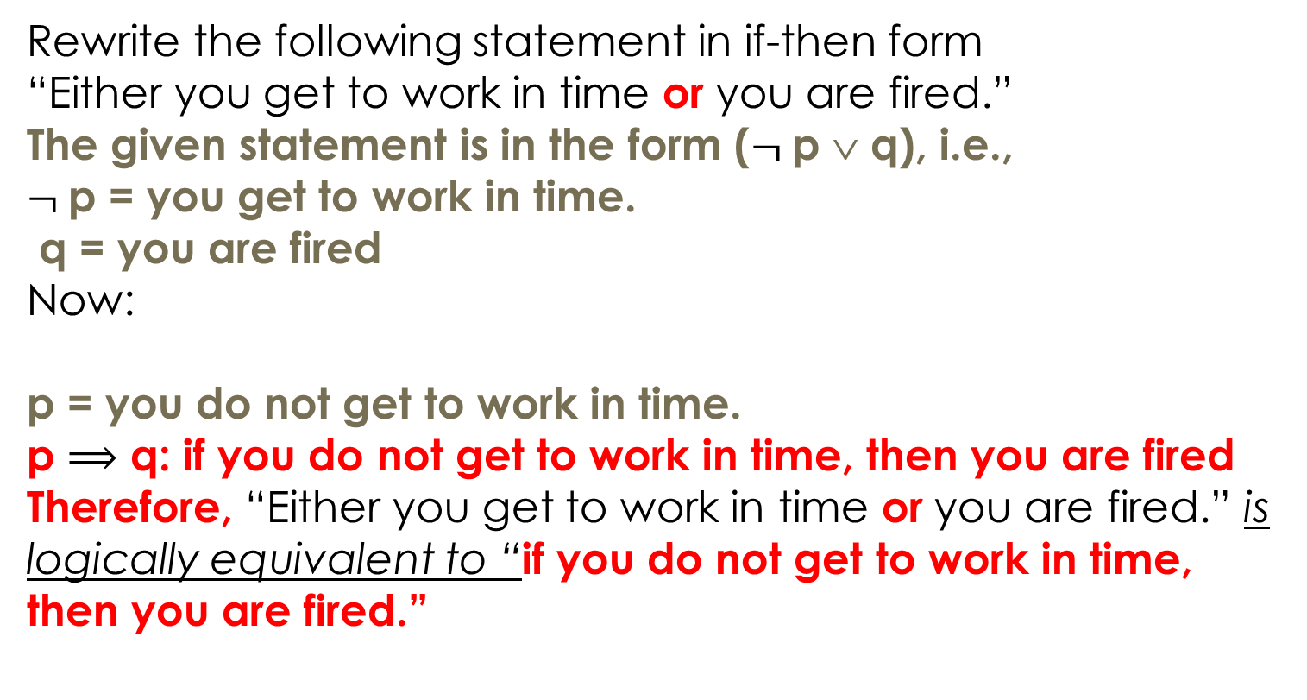
EXAMPLE: IMPLICATION LAW p $⟹$ q $⟺$ $¬$p ∨ q
Rewrite the following statement in if-then form
“Either you get to work in time or you are fired.”
The given statement is in the form ($¬$p ∨ q), i.e.,
$¬$p = you get to work in time.
q = you are fired
Now:
p = you do not get to work in time.
p $⟹$ q: if you do not get to work in time, then you are fired
Therefore, “Either you get to work in time or you are fired.” is logically equivalent to “if you do not get to work in time, then you are fired.”

Slide 23
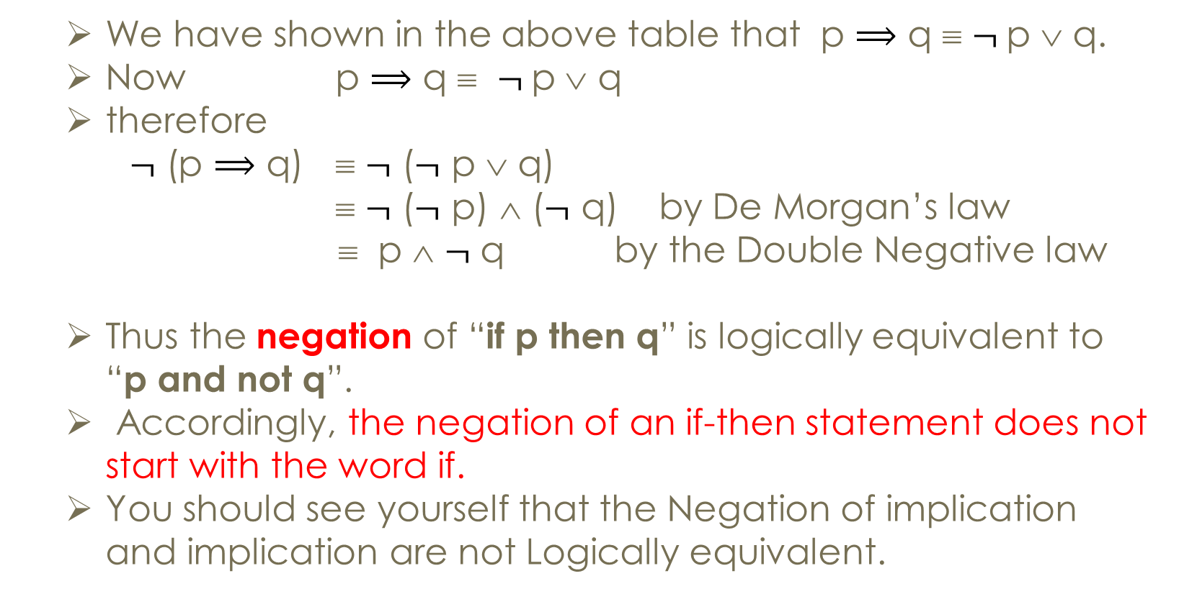
NEGATION OF A CONDITIONAL STATEMENT
We have shown in the above table that p $⟹$ q ≡ $¬$p ∨ q.
Now p $⟹$ q ≡ $¬$p ∨ q
therefore
$¬$ (p $⟹$ q) ≡ $¬$ ($¬$ p ∨ q)
≡ $¬$ ($¬$ p) ∧ ($¬$ q) by De Morgan’s law
≡ p ∧ $¬$ q by the Double Negative law
Thus the negation of “if p then q” is logically equivalent to “p and not q”.
Accordingly, the negation of an if-then statement does not start with the word if.
You should see yourself that the Negation of implication and implication are not Logically equivalent.

Slide 24
Summary of the lecture: conclusion
Conditional statement
Truth table for conditional statement
Implication form of conditional statement

Slide 25
Reference and reading material
Chapter # 3: Section 3.2 of the book “Software development with Z” by J.B. Wordsworth
Chapter # 2: of the book “Formal Software Development, from VDM to Java” by Quentin Charatan and Aaron Kans

